Slide 1
Introduction to Deep Learning
Alex Sanchez, Ferran Reverter and Esteban Vegas

Slide 2
Introduction

Slide 3
Session Outline
Towards Deep learning
Learning visual features
Convolutional Neural Networks
Building and Training CNNs
Applications of CNNs

Slide 4
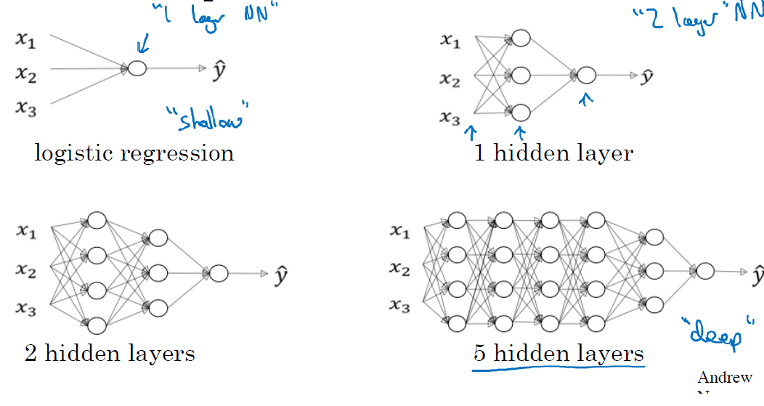
Deep Neural Networks
Neural Networks may have distinct levels of complexity.
Source: ‘Deep Learning’ course, by Andrew Ng in Coursera & deeplearning.ai

Slide 5
From Shallow to Deep NNs
“Deep Neural networks” are NNs with several hidden layers.
The real shift, from Shallow to Deep NNs, is not (only) the number of layers.
The difference comes from realizing that
Some tasks as digit recognition, could be solved decently well using a “brute force” approach
Other more complex tasks, such as distinguishing a human face in an image, where hard to solve witht that “brute” force approach.
This is often associated to working with structured vs unstructured data

Slide 6
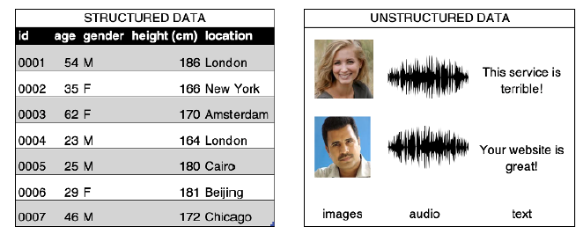
Structured-Unstructured data
‘Source: Generative Deep Learning. David Foster (Fig. 2.1)’

Slide 7
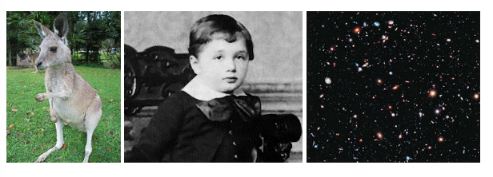
Images are unstructured data
Task: Distinguish human from non-human in an image
Source: ‘Neural Networkls and Deep Learning’ course, by Michael Nielsen

Slide 8
Face recognition problem
This can be attacked as the digit recognition problem (output of “yes” and “no”), although the cost of training the network would be much higher.
An alternative approach may be to try to solve the problem hierarchically.
We start by tying to find edges in the figure
In the parts with edges we “look around” to find face pieces, a nose, an eye, an eyebrow …
As we locate the pieces we look for their optimal combination.

Slide 9
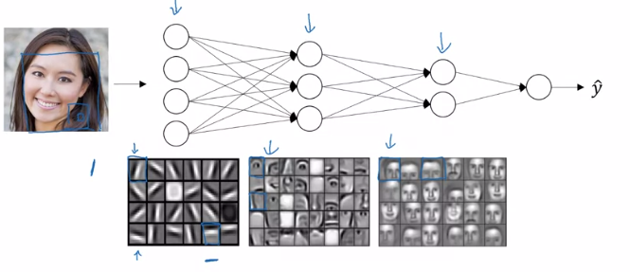
A hierarchy of complexity
Source: ‘Deep Learning’ course, by Andrew Ng in Coursera & deeplearning.ai

Slide 10
A hierarchy of complexity
Each layer has a more complex task, but it receives better information.
If we can solve the sub-problems using ANNs,
Perhaps we can build a neural network for face-detection, by combining the networks for the sub-problems.
Networks with this kind of many-layer structure - two or more hidden layers - are called deep neural networks.

Slide 11
Automatic tuning
In order for these networks to succeed it is important not having to hand-craft the complicated structure of weights and biases required for such hierarchy of layers and functions.
In 2006 techniques enabling learning in Deep Neural Nets were developed.
These deep learning techniques are based on stochastic gradient descent and backpropagation, but also introduce new ideas.
It turns out that equiped with such techniques, deep neural networks perform much better on many problems than shallow neural networks.

Slide 12
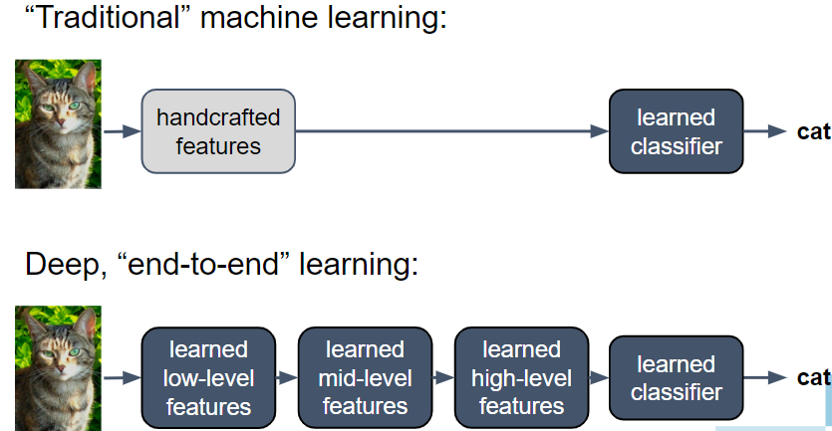
Shallow vs Deep NNs
Source: ‘Deep Learning’ course, by Andrew Ng in Coursera & deeplearning.ai

Slide 13
What do we mean by computers vision?

Slide 14
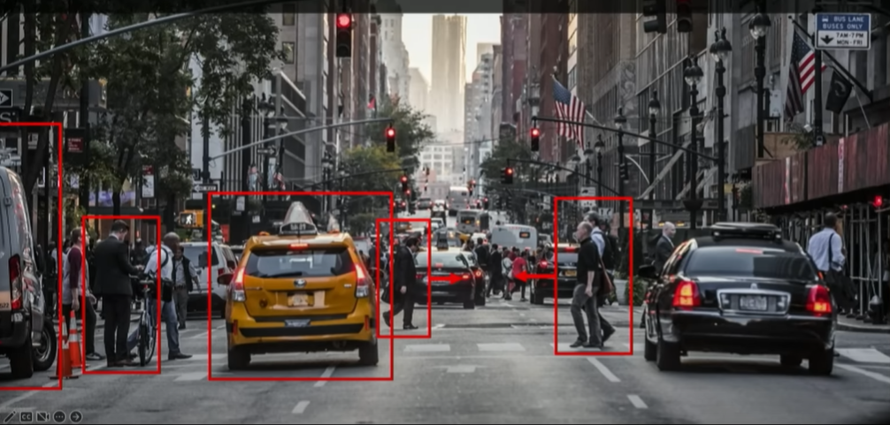
We want computers that can see
Goal: Computer systems able to see what is present in the world, but also to predict and anticipate events.
source: MIT Course, http://introtodeeplearning.com/, L3

Slide 15
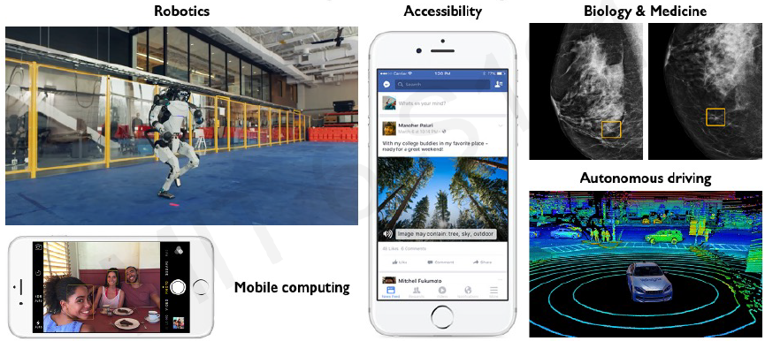
DNN in computer vision systems
Deep Learning enables many systems to undertake a variety of computer vision related tasks.
source: MIT Course, http://introtodeeplearning.com/, L3

Slide 16
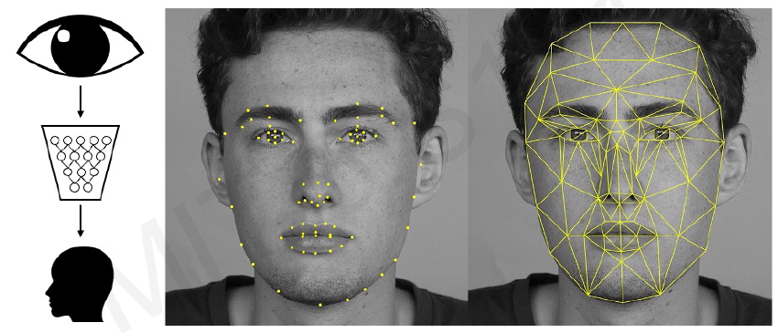
Facial detection and recognition
In particular it enables automatic feature extraction.
source: MIT Course, http://introtodeeplearning.com/, L3

Slide 17
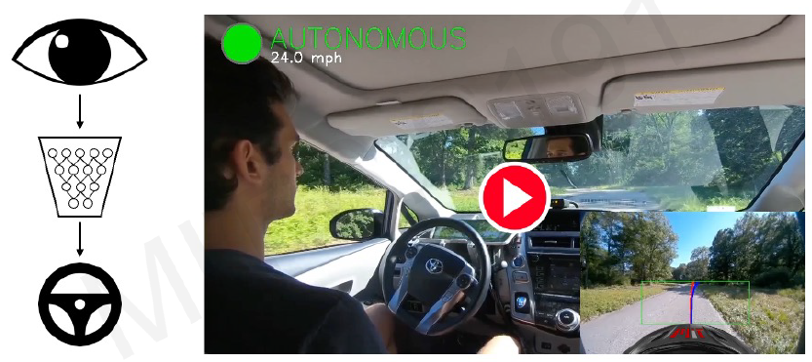
Autonomous driving
Autonomus Driving would not be possible without the possibility of performing Automatic Feature Extraction
source: MIT Course, http://introtodeeplearning.com/, L3

Slide 18
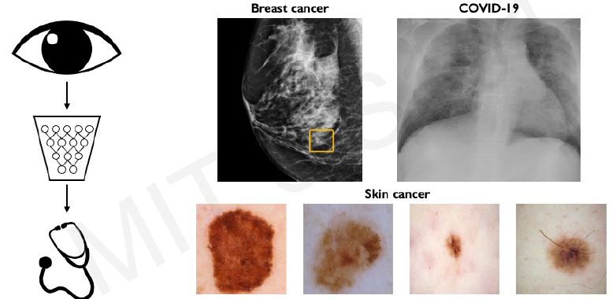
Medicine, biology, self care
Neither would systems for automatic disease detection be able to distinguish healthy from affected people though images.
source: MIT Course, http://introtodeeplearning.com/, L3

Slide 19
What computers see?

Slide 20
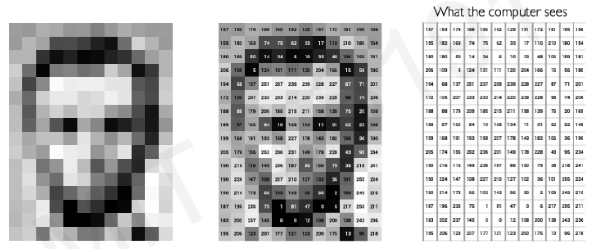
Images are numbers
To a computer images, of course, are numbers.
An RGB image is a NxNx3 matrix of numbers [0,255]
source: MIT Course, http://introtodeeplearning.com/, L3

Slide 21
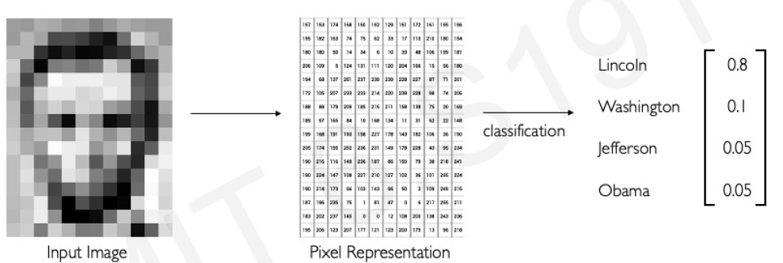
Main tasks in Computer Vision:
Regression: Output variable takes continuous value. E.g. Distance to target
Classification: Output variable takes class labels. E.g. Probability of belonging to a class
source: MIT Course, http://introtodeeplearning.com/, L3

Slide 22
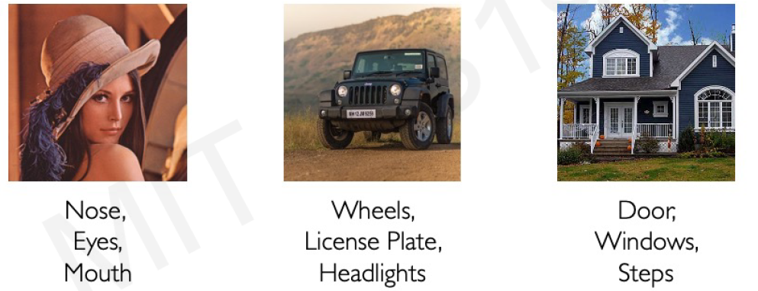
High level feature detection
A different set of features characterize each image
Before attempting to build a computer vision system, we need to be aware of what feature keys are in our data that need to be identified and detected.
source: MIT Course, http://introtodeeplearning.com/, L3

Slide 23
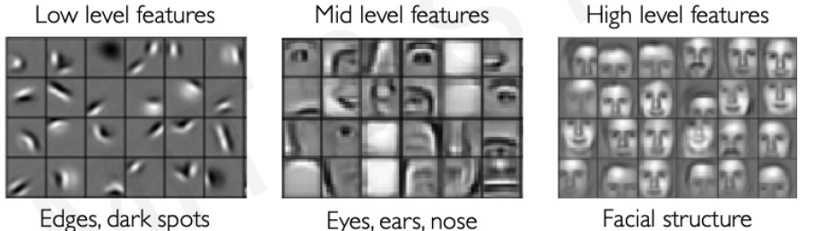
How to do feature extraction
Manual feature extraction is hard!
Feature characterization needs to define a hierarchy of features allowing an increasing level of detail.
Deep Neural networks can do this in a hierarchichal fashion!
source: MIT Course, http://introtodeeplearning.com/, L3

Slide 24
Learning visual features

Slide 25
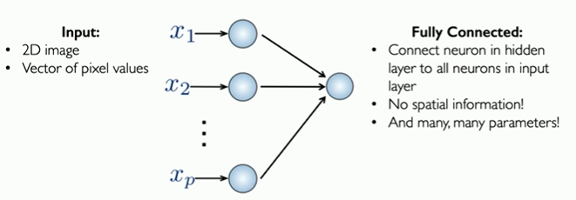
Feature extraction with dense NN
Fully connected NN could, in principle, be used to learn visual features
source: MIT Course, http://introtodeeplearning.com/, L3

Slide 26
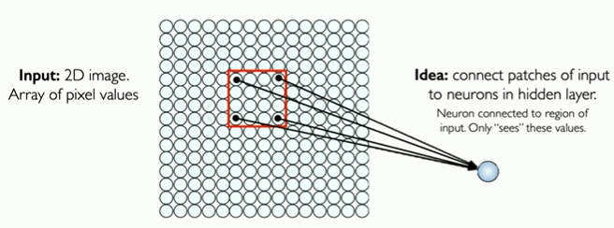
Accounting for spatial structure
Images have a spatial structure.
How can this be used to inform the architecture of the Network?
source: MIT Course, http://introtodeeplearning.com/, L3

Slide 27
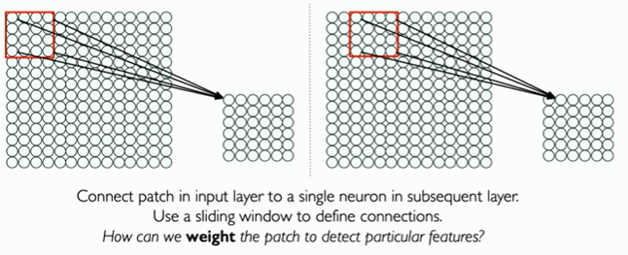
Extending the idea with patches
source: MIT Course, http://introtodeeplearning.com/, L3

Slide 28
Use filters to extract features
Filters can be used to extract local features
A filter is a set of weights
Different filters can extract different .
Filters that matter in one part of the input should matter elsewhere so:
Parameters of each filter are spatially shared.

Slide 29
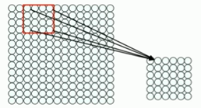
Shifting filters for Extraction
A 4x4: 16 distinct weights filter is applied to define the state of the neuron in the next layer.
Same filter applied to 4x4 patches in input
Shift by 2 pixels for next patch.
source: MIT Course, http://introtodeeplearning.com/, L3

Slide 30
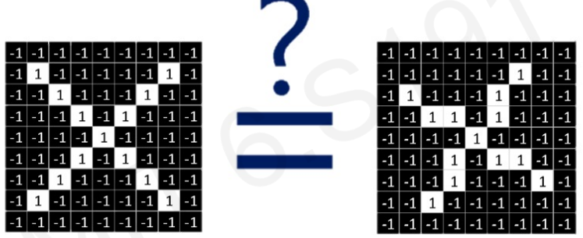
Example: “X or X”?
Images are represented by matrices of pixels, so
Literally speaking these images are different.
source: MIT Course, http://introtodeeplearning.com/, L3

Slide 31
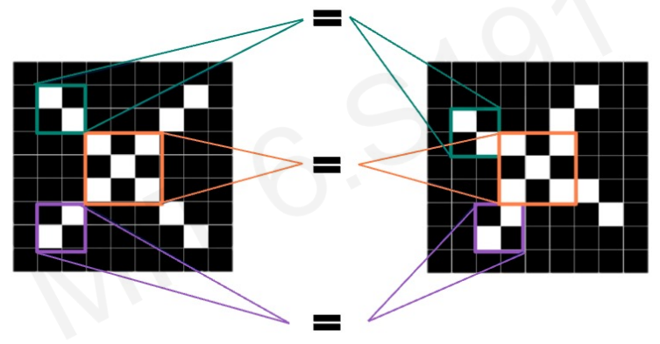
What are the features of X
Look for a set of features that:
characterize the images, and
and are the same in both cases.
source: MIT Course, http://introtodeeplearning.com/, L3

Slide 32
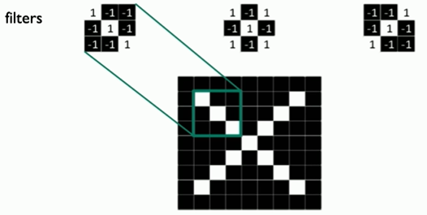
Filters can detect X features
source: MIT Course, http://introtodeeplearning.com/, L3

Slide 33
Is a given patch in the image?
The key question is how to pick-up the operation that can take
a patch and
an image and
An decide if the patch is in the image.
This operation is the convolution.

Slide 34
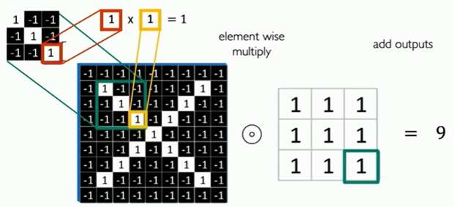
The Convolution Operation
source: MIT Course, http://introtodeeplearning.com/, L3
Notes:
Convolution matches the patch and the image by elementwise multiplication, followed by a sum.
Given the filters used (+1/-1) if there is absolute coincidence, as in the example, all multiplications will yield 1, and the sum will be 9.
Two completely different patches would add -9.

Slide 35
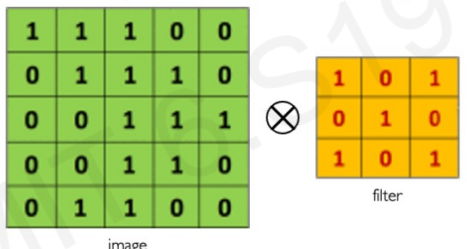
The Convolution Operation
Suppose we want to compute the convolution of a 5x5 image and a 3x3 filter.
source: MIT Course, http://introtodeeplearning.com/, L3

Slide 36
The Convolution Operation
Slide the 3x3 filter over the input image,
Elementwise multiply and
Add the outputs
source: MIT Course, http://introtodeeplearning.com/, L3

Slide 37
The Convolution Operation

Slide 38
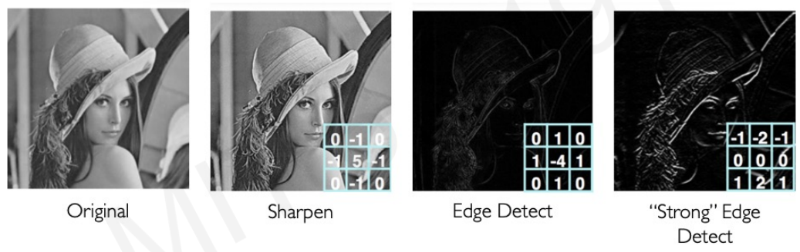
A filter for each pattern?
By applying different filters, i.e. changing the weights,
We can achieve completely different results

Slide 39
Can filters be learned?
Different filters can be used to extract different characteristics from the image.
Building filters by trial-and-error can be slow.
If a NN can learn these filters from the data, then
They can be used to classify new images.
This is what Convolutional Neural Networks is about.

Slide 40
Convolutional Neural Networks

Slide 41
CNNs: Overview
Convolutional Neural Networks are a type of DNN that implement the ideas previously introduced
Uses convolutions to learn spatial features.
Intended to identify increasingly complex traits by concatenating multiple convolutional layers.
Convolutional layers combined with dense layers that perform “classification” as usual from the output of convolutional layers.

Slide 42
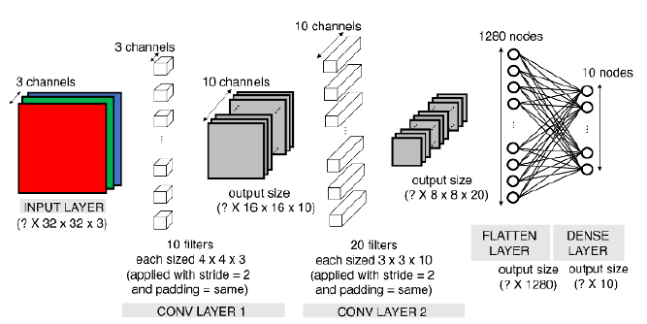
Another CNN outline
Source: Generative Deep Learning. David Foster (Fig. 2.13)

Slide 43
Convolutional Layers
The layers implementing convolutions.
Besides this, they proceed as usual for hidden layer
Weighted linear combination of (convoluted) values
$$z_{p,j}^{\left(l\right)}=\sum_{i=1}^{4}{\sum_{j=1}^{4}{w_{ij}}}x_{i+p,j+q}+b$$
Followed by non-linear transformation (ReLU)
$$a_{p,j}^{\left(l\right)}=max\left(0,z_{p,j}^{\left(l\right)}\right).$$

Slide 44
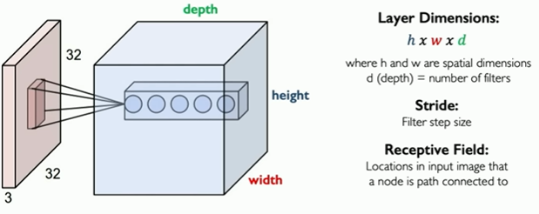
Filtering increases dimension
Multiple filters can be applied on the same image.
Adding filters increases the dimensionality of the filtered output
Think of the output as a volume.
source: MIT Course, http://introtodeeplearning.com/, L3

Slide 45
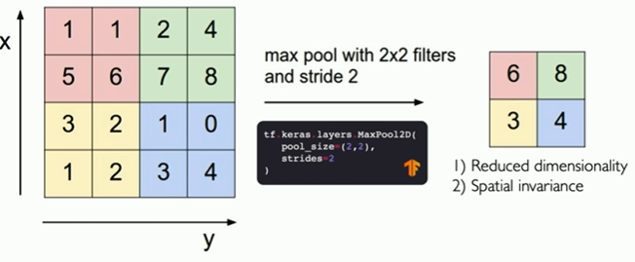
Pooling decreases dimension
Pooling downsamples feature maps to reduce the spatial dimensions of the feature maps while retaining the essential information.
source: MIT Course, http://introtodeeplearning.com/, L3

Slide 46
Pooling
Key objectives of pooling in CNNs:
Dimensionality Reduction:
Translation Invariance:
Robustness to Variations:
Extraction of Salient Features:
Spatial Hierarchy:

Slide 47
Common types of pooling
Max pooling
selects the maximum value within each pooling region,
Average pooling
calculates the average value.

Slide 48
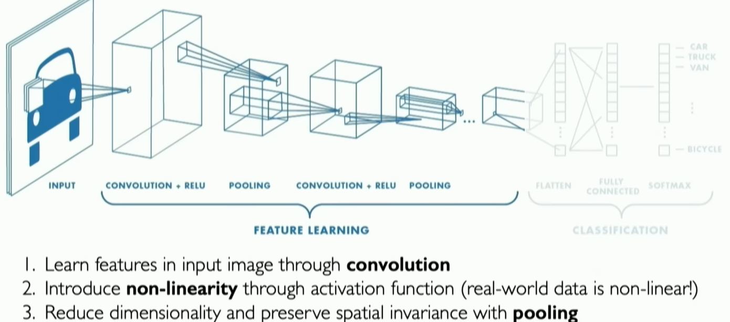
Summary: CNNs for classification
source: MIT Course, http://introtodeeplearning.com/, L3

Slide 49
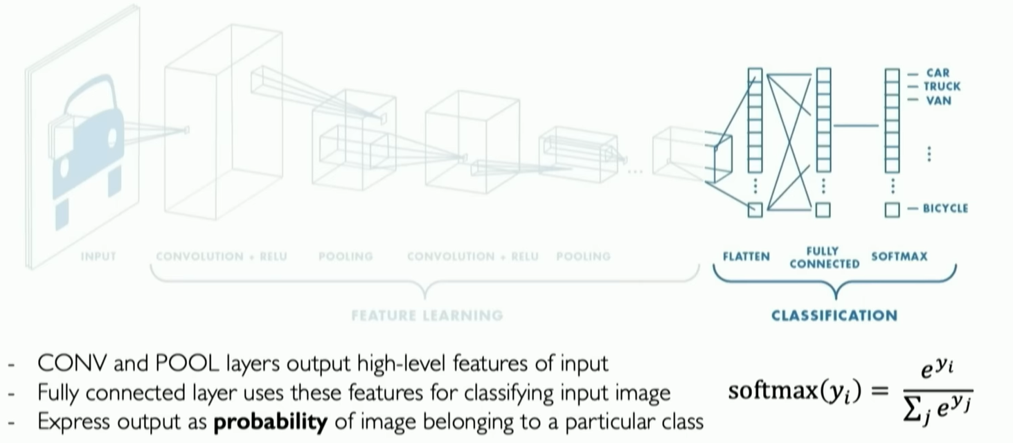
Summary: CNNs for classification
source: MIT Course, http://introtodeeplearning.com/, L3

Slide 50
A short mathematical digression: Tensors

Slide 51
Tensors
Deep learning is filled with the word “tensor”,
What are Tensors any way?
R users: familiar with vectors (1-d arrays) and matrices (2-d arrays).
Tensors extend this concept to higher dimensions.
Can be seen as multi-dimensional arrays that generalize matrices.
See the Wikipedia for a nice article on tensors

Slide 52
Why tensors?
Working with tensors has many benefits:
Generalization: Tensors generalize vectors and matrices to an arbitary number of dimensions,
Flexibility: can hold a wide range of data types.
Speed: Use of tensors facilitates fast, parallel processing computations.

Slide 53
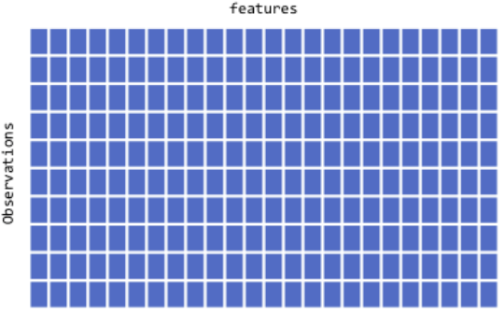

One and two dimensional tensors
Vectors:rank-1 tensors.
Matrices: rank-2 tensors.

Slide 54
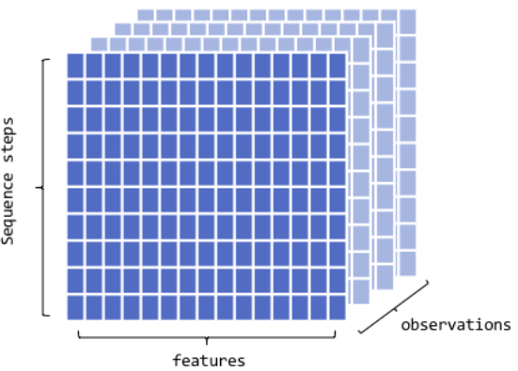
Rank three tensors
Arrays in layers.
Typic use: Sequence data
time series, text
dim = (observations, seq steps, features)
Examples
250 days of high, low, and current stock price for 390 minutes of trading in a day;
dim = c(250, 390, 3)
1M tweets that can be 140 characters long and include 128 unique characters;
dim = c(1M, 140, 128)

Slide 55
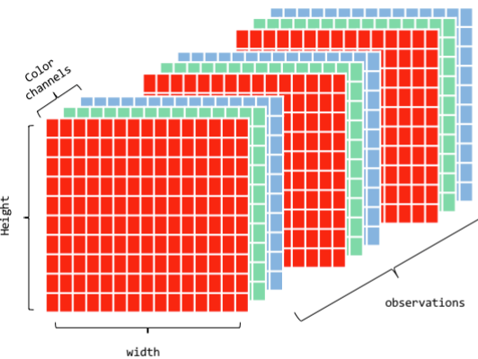
Rank four tensors
Layers of groups of arrays
Typic use: Image data
RGB channels
dim = (observations, height, width, color_depth)
MNIST data could be seen as a 4D tensor where color_depth = 1

Slide 56
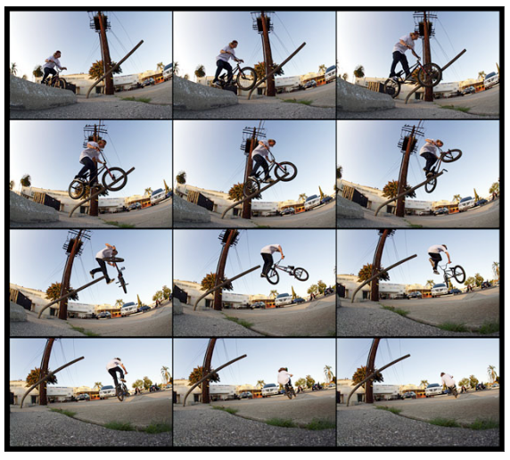
Rank five tensors
Typic use: Video data
samples: 4 (each video is 1 minute long)
frames: 240 (4 frames/second)
width: 256 (pixels)
height: 144 (pixels)
channels: 3 (red, green, blue)
Tensor shape (4, 240, 256, 144, 3)

Slide 57
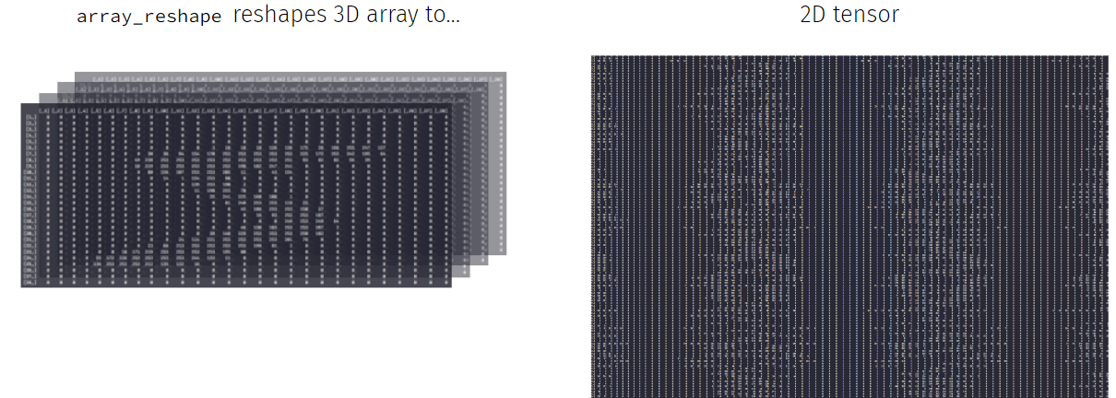
One can always reshape
Each DNN model has a given architecture which usually requires 2D/3D tensors.
If data is not in the expected form it can be reshaped.

Slide 58
See Deep learning with R for more.

Slide 59
Deep Learning Software

Slide 60
Which programs for DL?
TensorFlow
PyTorch
Keras
MXNet
Caffe
Theano
Microsoft Cognitive Toolkit (CNTK)

Slide 61

TensorFlow
Open-source DL framework developed by Google.
Flexible model development
Optimized for distributed computing and performance
High level APIS like Keras, in Python and R.

Slide 62

PyTorch
Open-source DL framework developed by facebook.
User-friendly interface and dynamic computational graph features with intuitive debugging and experimentation.
Highly integrated with Numpy

Slide 63

Keras
High-level neural networks API running on top of TensorFlow, CNTK, or Theano,
Emphasizes simplicity and ease of use.
AVailable in Python and R

Slide 64
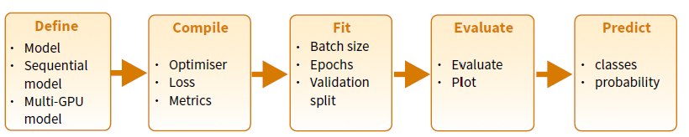
The Keras pipeline
Training and using a model in keras is intended to be done through the usual steps of a ML worfflow

Slide 65
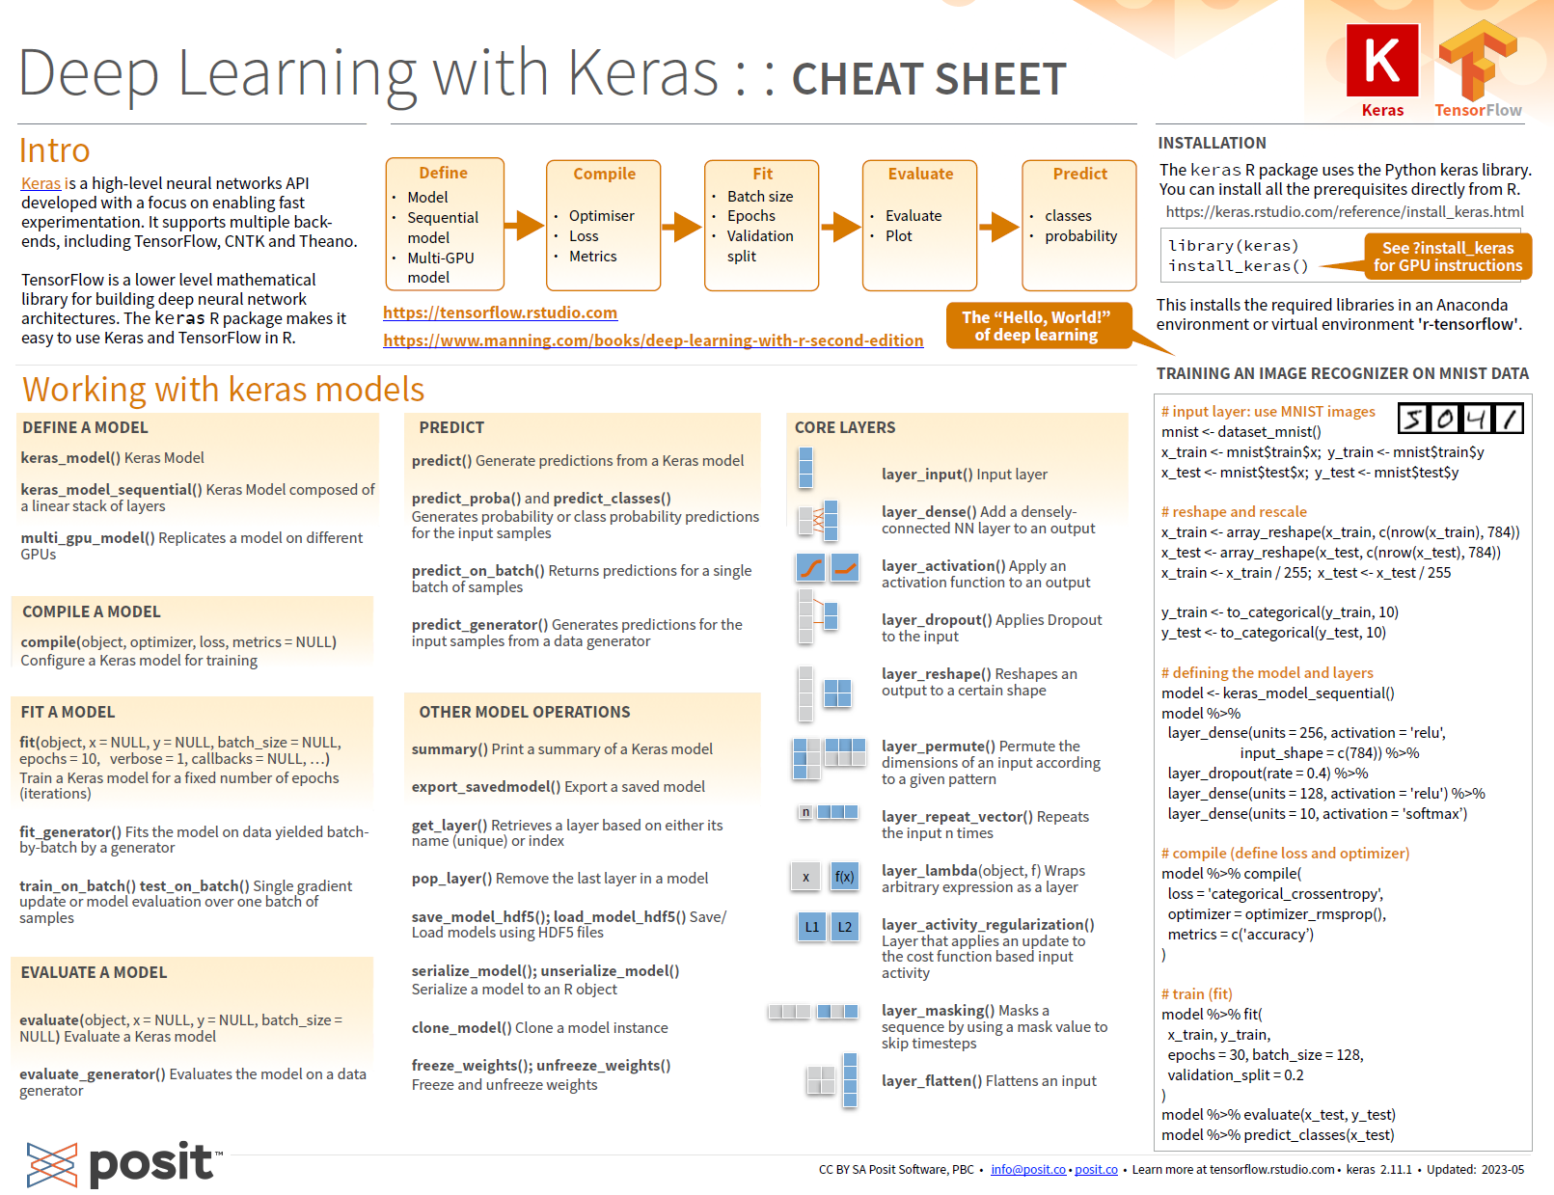
A keras cheat sheet

Slide 66
Available at rstudio github repo

Slide 67
A toy example

Slide 68
The MNIST dataset
A popular dataset or handwritten numbers.
library(keras) mnist <- dataset_mnist()
Made of features (images) and target values (labels)
Divided into a training and test set.
x_train <- mnist$train$x; y_train <- mnist$train$y x_test <- mnist$test$x; y_test <- mnist$test$y
(mnistDims <- dim(x_train)) img_rows <- mnistDims[2]; img_cols <- mnistDims[3]

Slide 69
Data pre-processing (1): Reshaping
These images are not in the the requires shape, as the number of channels is missing.
This can be corrected using the array_reshape() function.
x_train <- array_reshape(x_train, c(nrow(x_train), img_rows, img_cols, 1)) x_test <- array_reshape(x_test, c(nrow(x_test), img_rows, img_cols, 1)) input_shape <- c(img_rows, img_cols, 1) dim(x_train)

Slide 70
Data pre-processing (2): Other transforms
Data is first normalized (to values in [0,1])
x_train <- x_train / 255 x_test <- x_test / 255
Labels are one-hot-encoded using the to_categorical() function.
num_classes = 10 y_train <- to_categorical(y_train, num_classes) y_test <- to_categorical(y_test, num_classes)

Slide 71
Modeling (1): Definition
model <- keras_model_sequential() %>% layer_conv_2d(filters = 16, kernel_size = c(3,3), activation = 'relu', input_shape = input_shape) %>% layer_max_pooling_2d(pool_size = c(2, 2)) %>% layer_dropout(rate = 0.25) %>% layer_flatten() %>% layer_dense(units = 10, activation = 'relu') %>% layer_dropout(rate = 0.5) %>% layer_dense(units = num_classes, activation = 'softmax')

Slide 72
Modeling (1): Model Summary
model %>% summary()

Slide 73
Modeling (2): Compilation
Categorical cross-entropy as loss function.
Adadelta optimizes the gradient descent.
Accuracy serves as metric.
model %>% compile( loss = loss_categorical_crossentropy, optimizer = optimizer_adadelta(), metrics = c('accuracy') )

Slide 74
Model training
A mini-batch¹ size of 128 should allow the tensors to fit into the memory of most “normal” machines.
The model will run over 12 epochs,
With a validation split set at 0.2
batch_size <- 128 epochs <- 12 model %>% fit( x_train, y_train, batch_size = batch_size, epochs = epochs, validation_split = 0.2 )

Slide 75
Model evaluation
Use test data to evaluate the model.
model %>% evaluate(x_test, y_test) predictions <- model %>% predict(x_test) # Not shown

Slide 76
References and Resources

Slide 77
Resources (1)
Courses
An introduction to Deep Learning. Alex Amini. MIT
Coursera: Deep Learning Specialization. Andrew Ng
Books
Neural networks and Deep Learning
Deep learning with R, 2nd edition. F. Chollet

Slide 78
Resources (2)
Workshops
Deep learning with R Summer course
Deep learning with keras and Tensorflow in R (Rstudio conf. 2020)
Documents
Introduction to Convolutional Neural Networks (CNN)
Convolutional Neural Networks in R

Slide 79
Notes
1.
A batch is a collection of training examples processed together,
A minibatch is a smaller subset of a batch used for memory efficiency
An epoch is a complete pass of the entire training dataset during model training.

